Slide 1
Module -4 Internet Protocol
IP is an unreliable and connectionless datagram protocol -a best-effort delivery service.
Best-effort means that IP packets can be corrupted, lost, arrive out of order, or delayed and may create congestion for the network.
If reliability is important, IP must be paired with a reliable protocol such as TCP

Slide 2

Position of IPv4 in TCP/IP protocol suite

Slide 3

IPv4 datagram
(Packets in the network (internet) layer are called datagrams)

Slide 4
IPv4 Datagram Format
Version (VER): version of the IP protocol. Currently, the version is 4.
Header length (HLEN): the total length of the datagram header in 4-byte words.
Services: service type or differentiated services (not used now).
Total length: total length (header plus data) of the datagram in bytes.
  Total length of data = total length – header length

Slide 5
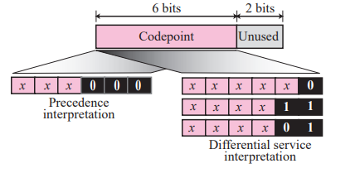
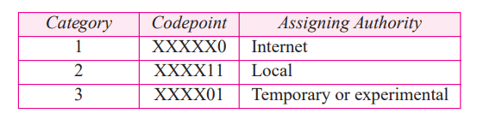
Service type
Values for codepoints

Slide 6
IPv4 Datagram Format
Identification: used in fragmentation (discussed later).
Flags: used in fragmentation (discussed later).
Fragmentation offset: used in fragmentation (discussed later).
Time to live: it is used to control the maximum number hops visited by the datagram.
Protocol: defines the higher-level protocol that uses the services of the IPV4 layer.

Slide 7
IPv4 Datagram Format
Checksum: 1’s compliment checksum (introduced in Chapter 10).
Source address: is the IPv4 address of the source.
Destination address: is the IPv4 address of the source.

Slide 8

Note
The total length field defines the total length of the datagram including the header.

Slide 9

Figure 20.7 Encapsulation of a small datagram in an Ethernet frame
One of the reason why “total length”
field is required.

Slide 10

Figure 20.8 Protocol field and encapsulated data

Slide 11

Table 20.4 Protocol values

Slide 12

Figure 20.9 Maximum transfer unit (MTU)

Slide 13

Table 20.5 MTUs for some networks

Slide 14
Fields Related to Fragmentation
Identification: identifies a datagram originating from the source host. A combination of the identification and source address must uniquely define a datagram as it leaves the source node.
Flags: see next slide.
Fragmentation offset: is the offset of the data in the original datagram measured in units of 8 bytes.

Slide 15

Figure 20.10 Flags (3 bits) used in fragmentation
first bit: reserved (not used)
second bit: = 1 requires the packet not to be fragmented
drops the packet if it is > MTU
third bit: =1 more fragmented packets later
=0 the last fragmented packet

Slide 16

Figure 20.11 Fragmentation example

Slide 17
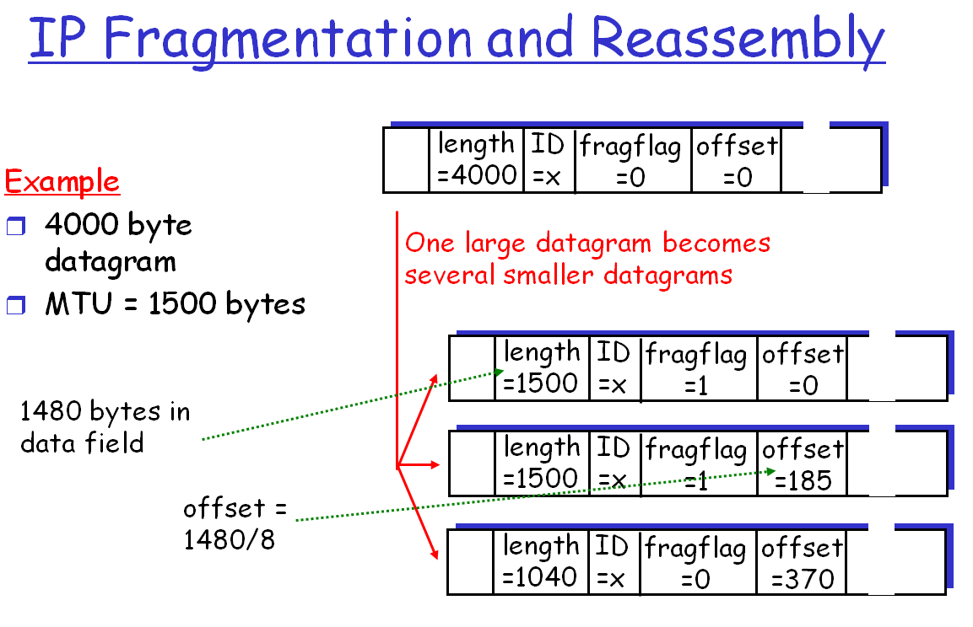
1060

Slide 18
IPv4 Checksum
IPv4 checksum use the 1’s compliment method (chapter 10)
Checksum only computes for IP header, not data
  Upper layer has checksum for data portion
  Header always changes in each router
Header is chunked to 16-bit sections for computing

Slide 19

Figure 20.13 Example of checksum calculation in IPv4

Slide 20
20-3 IPv6
The network layer protocol in the TCP/IP protocol suite is currently IPv4. Although IPv4 is well designed, data communication has evolved since the inception of IPv4 in the 1970s. IPv4 has some deficiencies that make it unsuitable for the fast-growing Internet.
Topics discussed in this section:
Advantages
Packet Format
Extension Headers

Slide 21
IPv6: Advantages
Larger address space.
Better header format.
New options.
Allowance for extensions.
Support for resource allocation.
Support for more security.

Slide 22

Figure 20.15 IPv6 datagram header and payload

Slide 23

Figure 20.16 Format of an IPv6 datagram
Priority
Protocol

Slide 24

Table 20.9 Comparison between IPv4 and IPv6 packet headers

Slide 25
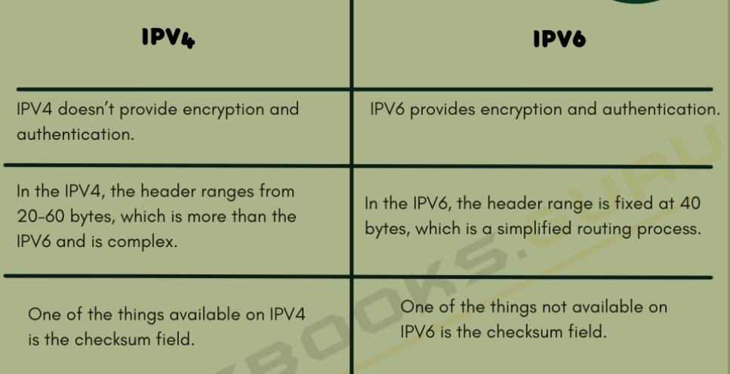

Slide 26
